Slide 1
SIT215 Artificial And Computational Intelligence
Problem solving task 3 – A game of Nim
Lee Copland
Philip Castiglione

Slide 2
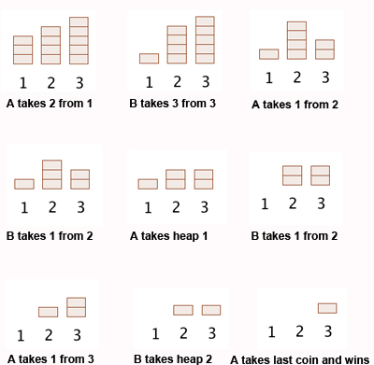
How to play Nim
Nim is a strategic game between two players
Tiles are arranged in heaps/rows
Players take turns picking up tiles, can pick any number of tiles from a singular row
Two game modes:
Normal – Player who picks up the last tile wins
Misère – Player who picks up the last tile loses
Image from:
https://plus.maths.org/content/play-win-nim

Slide 3
Skills Audit
Skill | Level of knowledge (None, Basic, Competent, Proficient) | Action(s) to improve
Problem Domain: What tools and knowledge is required to implement ‘a game of Nim’ | Lee: None Phil: Basic | Overview on the game of Nim https://en.wikipedia.org/wiki/Nim Implementing Nim in python https://www.youtube.com/watch?v=NqsZ8DD6WHU Strategies and Maths behind Nim https://plus.maths.org/content/play-win-nim
Minimax algorithm | Lee: None Phil: Proficient | Overview of the Minimax Algorithm https://en.wikipedia.org/wiki/Minimax How to implement the Minimax algorithm in python https://tonypoer.io/2016/10/28/implementing-minimax-and-alpha-beta-pruning-using-python/
Validation | Lee: None Phil: Basic | Develop a test strategy Research and understand invariants https://www.coursera.org/lecture/principles-of-computing-2/invariants-3eZ53

Slide 4
Solution Challenges
The AI needs to be able to model the unpredictable nature of a human player’s moves.
The solution needs to involve an interactive environment where both the human player and the AI can interact together.
The program needs to be able to handle different cases based on the game mode (normal or misère), where the AI strategy needs to reflect the difference in winning conditions.

Slide 5
AI Strategy
where we can talk about minimax and how it works, also so we can discuss the choice to use full/complete tree generation at the start of the game, rather than using alpha-beta pruning, so the AI always makes an optimal move throughout the game rather than requiring recalculation of the tree after each player move (because the player might make a sub-optimal move and then the AI hasn't calculated that path)

Slide 6
Our Solution
Initialisation
Create tiles
Game state
All possible moves calculated
AI selects move with best chance of winning
???
Game continues I guess?
Completion
AI wins
Prompt to play again
Choose player
Define rules of the game
More black magic

Slide 7
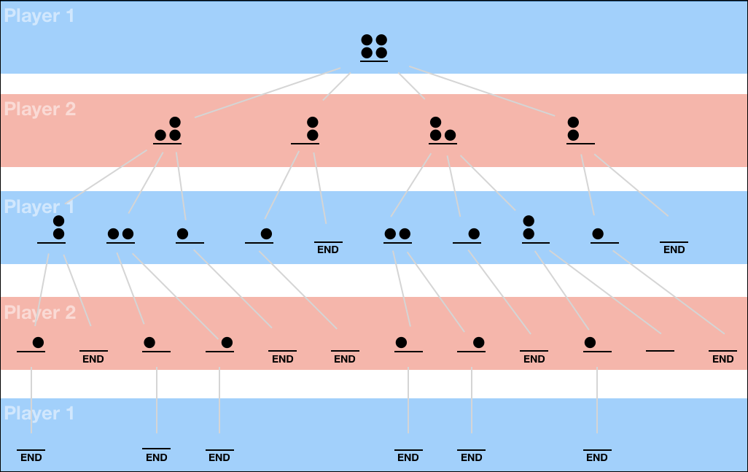
Demonstration

Slide 8
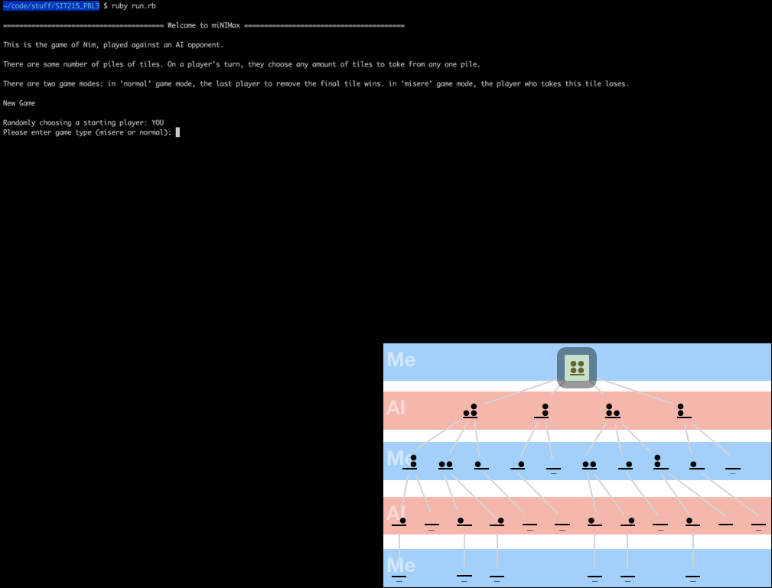
Demonstration - continued

Slide 9
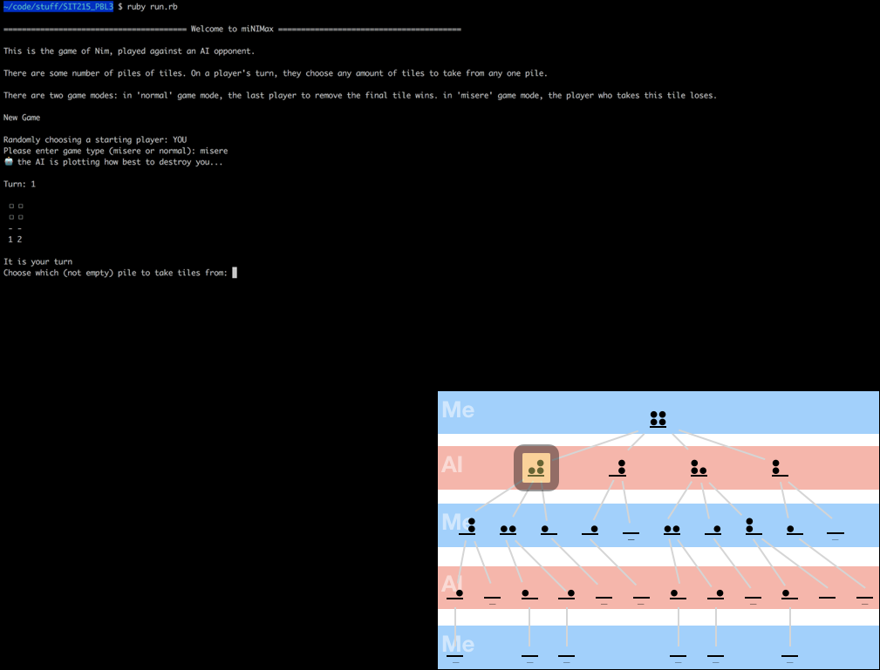
Demonstration - continued

Slide 10
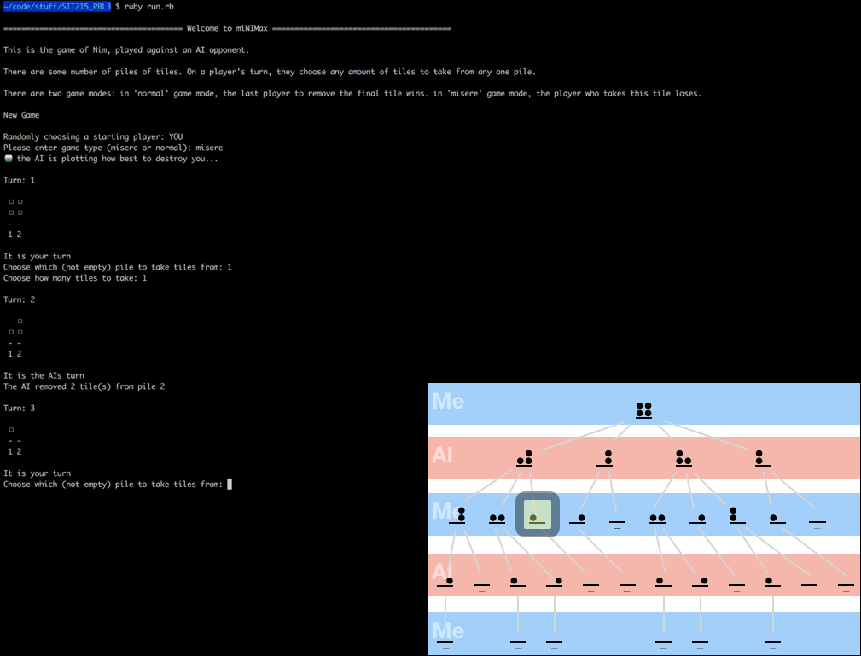
Demonstration - continued

Slide 11
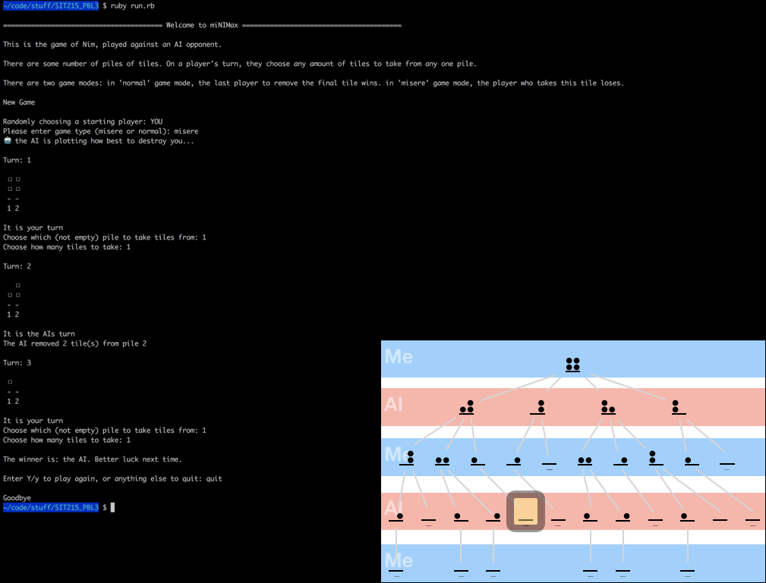
Demonstration - continued

Slide 12
Limitations and constraints
Large number of heaps/rows is very computationally expensive
The game is deterministic and the AI will always win unless you have a guaranteed win from the starting position

Slide 13
References and conclusion
Repository for the program is here: https://github.com/PhilipCastiglione/SIT215_PBL3

